Slide 1
Statistical and Predictive Modeling Assignment 1- Multivariate Regression Model
Name of the Student: Maisha Khatoon Student ID: 100899259

Slide 2
Rationale Statement
This presentation aims to give a thorough study of a regression model that was created to forecast diamond prices depending on several characteristics, including dimensions (x, y, and z), carat, depth, table, and categorical attributes like cut, color, and clarity. The main goals are to evaluate the model's effectiveness and determine how these factors affect diamond prices. We will also provide practical suggestions for enhancing the model in the future and for making wise business decisions.

Slide 3
The written form of the Multivariate Regression Model
The standard equation for multivariate regression can be represented as:
Y=β0​+β1​X1​+β2​X2​+...+βp​Xp​+ϵ
The regression model can be written as:
Price = B0 + B1 Carat + B2 Clarity + B3 Color + B4 Cut + B5 Depth + B6 Table + B7 Length + B8 Width + B9 Depth
Price=3945.97+5423.170294×Carat+(−91.829051)×Depth+(−58.169284)×Table+(−1190.321358)×Length+5.334533×Width+(−50.839380)×Depth

Slide 4
Explanation of Coefficients
Carat (5423.17): The price of a diamond is greatly increased by a higher carat weight. About 5423.17 units are added to the price for every carat added.
Depth (-91.83): The price of deeper diamonds is somewhat impacted by their depth; for every unit of depth added, the price is reduced by about 91.83 units.
Table (-58.17): The price is also marginally reduced by larger tables; for every unit of table size, the price is reduced by about 58.17 units.
Dimensions (x, y, z): The price is greatly reduced by the length (x), while the breadth (y) and depth (z) have little effect.
Cuts: Diamonds with better cuts (Good, Ideal, Premium, and Very Good) command higher prices as compared to the baseline "Fair," with the Ideal cut having the most beneficial influence.
Color: Diamonds with colors E to J are less expensive than those with baseline "D," with color J having the biggest negative effect.
Clarity: Higher clarity grades (IF, SI1, SI2, VS1, VS2, VVS1, VVS2), when compared to the baseline "I1," result in higher prices; VS2 has the greatest favorable effect.

Slide 5
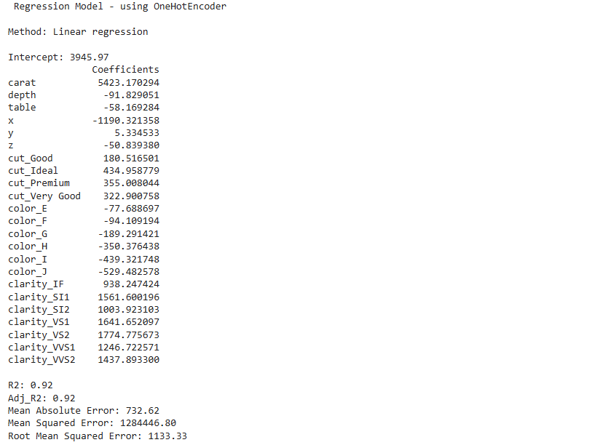
The Regression Model Output

Slide 6
Explanation of Adj.R², MAE, and RMSE metrics for the Model
Adjusted R² (0.92): This is a very high number that suggests a good fit, meaning that 92% of the variance in diamond prices is explained by the model.
Mean Absolute Error (MAE: 732.62): The model's forecasts are 732.62 units off the actual prices on average.
Root Mean Squared Error (RMSE: 1133.33): This figure shows the residuals' standard deviation by taking the square root of the average squared differences between the actual and forecast prices. A better match is indicated by a lower RMSE.
Mean Squared Error (MSE: 1284446.80): The average of the squared errors or mean squared error is a useful indicator of model correctness; however, it is easier to understand when presented as root mean square error (RMSE).

Slide 7
Results discovered from the Analysis
Larger carat weights significantly increase the price of diamonds, making carat weight the most important factor in predicting diamond prices.
Cut Quality: The price of superior cuts, like "Ideal" and "Very Good," is much higher than that of the standard "Fair" cut.
Clarity Grades: Increased clarity grades (such as VS2, and VS1) show that purchasers prefer diamonds with fewer inclusions and have a significant positive effect on pricing.
Color classes: The price of diamonds drops from D to J in comparison to E to J, with the decline being more pronounced for lower color classes.
Dimensions: While depth (z) and breadth (y) have little bearing on pricing, length (x) has a significant negative impact.
Model Performance: The model's high Adjusted R² value of 0.92 shows that it does a good job of capturing the main factors that affect diamond prices.
Error Metrics: Although there is space for improvement, the Root Mean Squared Error (1133.33) and Mean Absolute Error (732.62) point to a rather accurate model.

Slide 8
Recommendations for Mr. John Hughes
Model Refinement and Validation:
Take actions: Examine non-linear correlations and interaction terms to further hone the model and use cross-validation methods to confirm the results.
Justification: By doing this, you can make sure that the model is stable and applies well to new data, which could increase forecast accuracy.
Feature Engineering and Information Gathering:
Actions can be taken by gathering more information and considering other pertinent characteristics including polish, symmetry, and fluorescence. To capture more intricate patterns, improve feature engineering.
Justification: Adding and honing features can result in a more complete model that considers more subtle aspects of diamond price, which will increase the precision and dependability of predictions.

Slide 9
Conclusion
A reliable framework for forecasting diamond prices based on carat, cut, color, clarity, and dimensions is offered by the linear regression model. The model's strong Adjusted R² value of 0.92 highlights how well it explains price variations. Diamond prices are heavily influenced by crucial characteristics such as carat weight, cut quality, and clarity; specific physical dimensions and color grading also have a considerable impact. According to the investigation, adding more features and increasing model complexity can boost prediction accuracy even more. These insights provide a useful foundation for pricing strategies and point out areas for possible data enhancement and model refinement for stakeholders such as Mr. John Hughes.

Slide 10
Thank you.

